Slide 1
DFD Example
Lemonade Stand

Slide 2
Creating Data Flow Diagrams Steps
Create a list of activities and external entities.
Construct Context Level DFD.
  Diagram includes only one process which represents hole system.
  Diagram identifies external entities and processes.
Construct Level 0 DFD.
  Diagram shows some of the detail of the system being modeled with more than process.
  Diagram identifies manageable sub-process.
Construct Level 1-n DFD.
  Diagram identifies actual data flows and data stores.
Draw process decomposition diagram.
In all steps check against rules of DFD.
  Check legal and illegal data flows.
  Check naming.

Slide 3
DFD Guidelines
Every “Process” (rounded rectangle) has:
  A unique number
  A name (verb phrase)
Every “Data Flow” (unidirectional arrow) has:
  A name (a noun)
Every “Data Store” (open ended narrow rectangle) has:
  A unique number
  A name (a noun)

Slide 4
DFD Guidelines - 2
Every “Entity” (rectangle) has:
  A name (a noun)
Data flows (unidirectional arrows) are permitted only:
  Between processes.
  From a data store to a process.
  From a process to a data store.
  From a source to a process.
  From a process to a sink.

Slide 5
Creating Data Flow Diagrams
Scenario
Suppose that you are the owner of a lemonade stand and your employee is/employees are making fresh lemonades (on demand) and sell them.
Create a List of Activities and Entities
  Old way: no Use-Case Diagram
  New way: use Use-Case Diagram
Construct Context Level DFD
  Identifies sources and sink.
  Identifies a process which represent the system.
Construct Level 0 DFD
  Identifies manageable sub-processes. Divide the single process in context diagram into sub-processes.
Construct Level 1-n DFD
  Identifies actual data flows and data stores.
Draw Process Decomposition Diagram

Slide 6
Creating Data Flow Diagrams - 2
Find a process that generalizes the function of the entire system.
Think through the activities that take place at a lemonade stand and try to group these activities in some logical fashion, possibly functional areas.
Create a List of Activities
  Lemonade System
  Producing goods
    Produce product
    Store product
  Selling products
    Customer order
    Serve product
    Collect payment
  Collecting supplies
    Order raw materials
    Pay for raw materials
  Payment
    Time worked
    Pay for labor

Slide 7
Creating Data Flow Diagrams - 2
External entity is a source or destination of a data flow which is outside the area of study (domain).
List external entities.
Create a List of Entities
  Entity required for selling products
    Customer entity
  Entity required for collecting supplies
    Vendor entity
  Entity required for producing goods and payment
    Worker entity

Slide 8
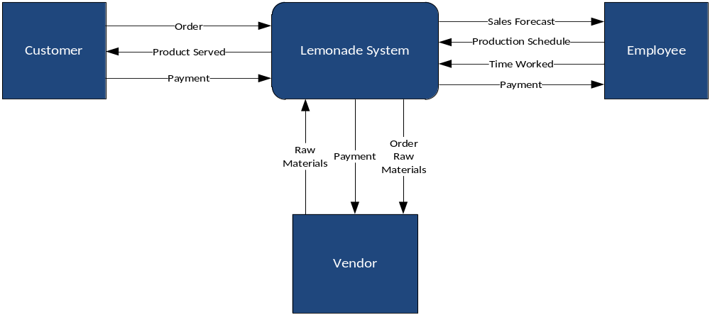
Construct Context Level DFD
Context Level DFD shows the interaction between the system and external agents.

Slide 9
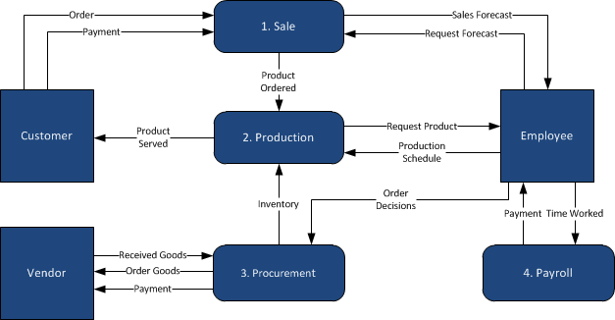
Construct Level 0 DFD

Slide 10
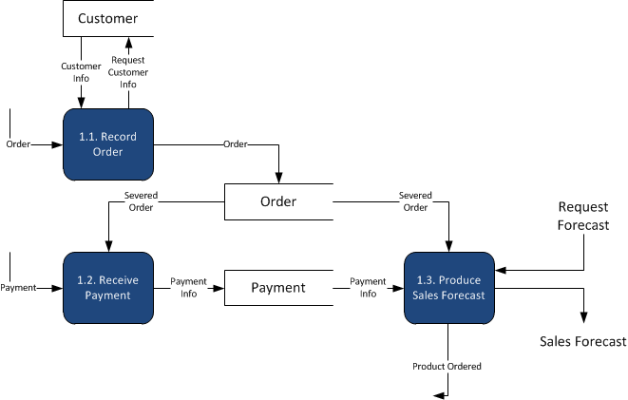
Construct Level 1 DFD - Sales
Create a Level 1 DFD by decomposing the processes in level 0 and identifying data stores (if necessary).
Processes in Level 0 DFD
Sales
Production
Procurement
Payroll
Sale Process

Slide 11
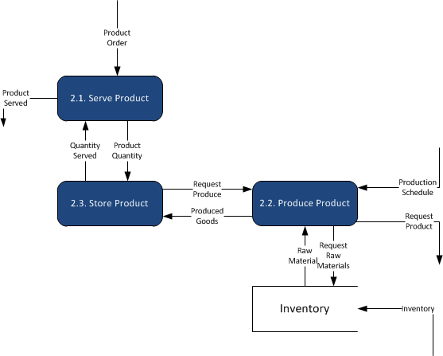
Construct Level 1 DFD - Production
Production Process

Slide 12
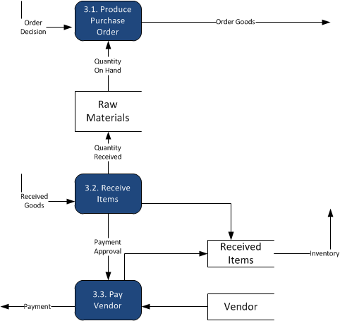
Construct Level 1 DFD - Procurement
Procurement Process

Slide 13
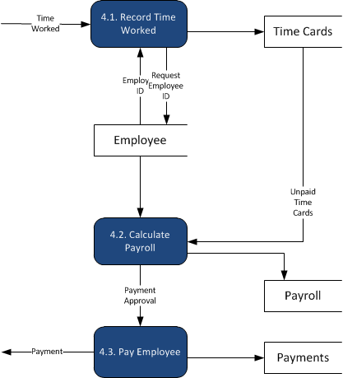
Construct Level 1 DFD - Payroll
Payroll Process

Slide 14
Process Decomposition Diagram
1. Sale
1.1
Record Order
1.2
Receive Payment
2. Production
2.1
Serve Product
2.2
Produce Product
2.3
Store
Product
Lemonade System
3. Procurement
3.1
Produce Purchase Order
3.2
Receive Items
3.3
Pay Vendor
4. Payroll
4.1
Record Time Worked
4.2
Calculate Payroll
4.3
Pay Employee
Context Level
Level 0
Level 1

